Slide 1
LANGUAGES FAQs
What are nouns?
The name of a person or place, or any word you can put ‘the’, ‘a/an’ in front of.
What are the definite and indefinite article?
‘The’ is the definite article and ‘a’ or ‘an’ is the indefinite article
Why do nouns have genders?
They just do and it is important to learn them. The gender relates to the spelling of the word.
What are adjectives?
Words which describe nouns.
What are pronouns?
Words which replace nouns, such as ‘he’, ‘she’ or ‘it’.
What are verbs?
Verbs are often called ‘action words’, although they are not all very active! For example, ‘to be’ is a verb, so is ‘to think’ and so is ‘to feel’. Verbs have a subject, which is the person or thing doing the verb: Tom feels happy: Tom is the subject and feels is the verb. All sentences need at least one verb!
Why are verbs regular or irregular?
They just are and it is important to learn them. There is normally a pattern to help you learn. Some verbs in English are irregular, too: the verb ‘to be’ for example – I am /you are / he is and – in the past – I was / you were. Very irregular!
What are adverbs?
Words which describe how a verb is done: slowly, intelligently, fast, lovingly, amusingly, beautifully etc
Does spelling matter?
Absolutely, yes! Spelling is generally easier in French and German, because the languages are fairly phonetic; they look like they sound!
Does pronunciation matter?
Yes, so try to sound as French or German as you can!

Slide 2
Gender and Plural
 | Masculine | Feminine | Plural
the | LE (L’) | LA (L’) | LES
A / an (SOME) | UN | UNE | DES
my | MON | MA | MES
your | TON | TA | TES
His / her | SON | SA | SES
our | NOTRE | NOTRE | NOS
your | VOTRE | VOTRE | VOS
their | LEUR | LEUR | LEURS
This / these | CE (CET) | CETTE | CES
Definite article
Indefinite article
Possessive
adjective
Demonstrative
adjective

Slide 3
Gender and Plural – Extension 1
 | Masculine | Feminine | MASCULINE Plural | FEMININE PLURAL
Which? | QUEL? | QUELLE? | QUELS? | QUELLES?
WHICH ONE? | LEQUEL? | LAQUELLE? | LESQUELS? | LESQUELLES?
THE ONE | CELUI | CELLE | CEUX | CELLES
THIS ONE / THESE (HERE) | CELUI-CI | CELLE-CI | CEUX-CI | CELLES-CI
THAT ONE / THOSE (THERE) | CELUI-LÀ | CELLE-LÀ | CEUX-LÀ | CELLES-LÀ
Interrogative adjective
Interrogative pronoun
Demonstrative
pronoun

Slide 4
Gender and Plural – Extension 2
 | Masculine | Feminine | MASCULINE Plural | FEMININE PLURAL
mine | LE MIEN | LA MIENNE | LES MIENS | LES MIENNES
yours | LE TIEN | LA TIENNE | LES TIENS | LES TIENNES
His / hers | LE SIEN | LA SIENNE | LES SIENS | LES SIENNES
ours | LE NÔTRE | LA NÔTRE | LES NÔTRES
yours | LE VÔTRE | LA VÔTRE | LES VÔTRES
theirs | LE LEUR | LA LEUR | LES LEURS
Possessive
pronoun

Slide 5
Les règles avec à et de The rules with à and de
À = to / at / in
De = of /from
à + la = à la
à + l’ = à l’
MAIS!
à + le = au
à + les = aux
You cannot say
à le or à les!
de + la = de la
de + l’ = de l’
MAIS!
de + le = du
de + les = des
You cannot say
de le or de les!
These rules apply every time you use à or de in front of the definite article!

Slide 6
The present tense of regular verbs:
-er verbs
-ir verbs
-re verbs
Jouer – to play
Je joue
Tu joues
Il joue
Elle joue
Nous jouons
Vous jouez
Ils jouent
Elles jouent
Finir –to finish
Je finis
Tu finis
Il finit
Elle finit
Nous finissons
Vous finissez
Ils finissent
Elles finissent
Vendre – to sell
Je vends
tu vends
Il vend
Elle vend
Nous vendons
Vous vendez
Ils vendent
Elles vendent

Slide 7
The present tense of modal verbs:
Vouloir – to want
Pouvoir – to be able / can
Devoir – to have to / must
Je veux
Tu veux
Il veut
Elle veut
Nous voulons
Vous voulez
Ils veulent
Elles veulent
Je peux
Tu peux
Il peut
Elle peut
Nous pouvons
Vous pouvez
Ils peuvent
Elles peuvent
Je dois
Tu dois
Il doit
Elle doit
Nous devons
Vous devez
Ils doivent
Elles doivent
MODAL VERBS ARE FOLLOWED BY THE INFINITIVE OF ANOTHER VERB!

Slide 8
The present tense of AVOIR and ÊTRE:
Avoir – to have
ÊTRE – to BE
J’ai
Tu as
Il a
Elle a
Nous avons
Vous avez
Ils ont
Elles ont
I have
You have
He has
She has
We have
You have
They have
They have
Je suis
Tu es
Il est
Elle est
Nous sommes
Vous êtes
Ils sont
Elles sont
I am
You are
He is
She is
We are
You are
They are
They are

Slide 9
The present tense of ALLER and FAIRE:
ALLER – to GO
FAIRE – TO DO / TO MAKE
Je vais
Tu vas
Il va
Elle va
Nous allons
Vous allez
Ils vont
Elles vont
I go
You go
He goes
She goes
We go
You go
They go
They go
Je fais
Tu fais
Il fait
Elle fait
Nous faisons
Vous faites
Ils font
Elles font
I do/make
You do/make
He /she
does / makes
We do/make
You do/make
They do /
make

Slide 10
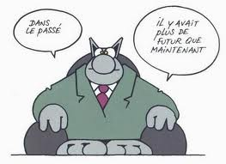

Slide 11
Le passé composé - the perfect tense
This is a PAST TENSE: it describes what has
ALREADY HAPPENED!
You use it to describe events which happened ONCE, often SUDDENLY OR things which happened over a DEFINED period of TIME.
There are 3 PARTS to the passé composé:
A subject – the person(s) or thing(s) who did the verb!
An auxiliary verb – the correct part of the present tense of either avoir or être.
The past participle: what has been done.

Slide 12
Le passé composé des verbes réguliers the perfect tense of regular verbs
Most verbs have avoir (to have) as their auxiliary verb.
1 : Who did the verb? This is the subject of the verb!
2 : Choose the right part of avoir to match the subject
Start with the infinitive of the verb! That’s the bit you find in the dictionary and it always ends in –er, -ir or –re!
J’ai
Tu as
Il a
Elle a
Nous avons
Vous avez
Ils ont
Elles ont
3: Follow this
with the
past
participle of
the verb you want to
use.
Regular verbs
follow this
pattern:
The subject could
be the name of a
person, place
or thing!
-ER VERBS:
REMOVE THE FINAL –ER AND ADD –É
-IR VERBS:
REMOVE THE FINAL –IR AND ADD -I
-RE VERBS:
REMOVE THE FINAL –RE AND ADD -U

Slide 13
LE PASSÉ COMPOSÉ AVEC AVOIR: VERBES RÉGULIERS
The subject (1)and auxiliary (2) can change.
The subject and auxiliary must match each other – they are linked!
The past participle (3) stays the same, regardless of who did it!
(1) | (2) | (3) | En anglais!
j’ | ai | joué | I (have) played
tu | as | visité | You (have) visited
il | a | aimé | He (has) liked
elle | a | mangé | She (has) eaten
on | a | parlé | We (have) spoken
nous | avons | écouté | We (have) listened
vous | avez | fini | You (have) finished
ils | ont | réussi | They (have) succeeded
elles | ont | répondu | They (have) replied
Never forget the auxiliary!
We can miss out the ‘have’ or ‘has’ in English, but it cannot be missed out in French!

Slide 14
Irregular past participles of common irregular verbs (avoir)
Infinitif | Participe passé | Infinitif | Participe passé
Avoir – to have | J’ai eu | Offrir – to offer | J’ai offert
Boire – to drink | J’ai bu | Ouvrir – to open | J’ai ouvert
Connaître – to know | J’ai connu | Pouvoir – to be able | J’ai pu
Courir- to run | J’ai couru | Prendre – to take | J’ai pris
Craindre – to fear | J’ai craint | Recevoir– to receive | J’ai reçu
Croire – to believe | J’ai cru | Rire – to laugh | J’ai ri
Devoir – to have to | J’ai dû | Savoir – to know | J’ai su
Dire – to say | J’ai dit | Suivre – to follow | J’ai suivi
Écrire – to write | J’ai écrit | Vivre – to live | J’ai vécu
Être – to be | J’ai été | Voir – to see | J’ai vu
Faire – to do | J’ai fait | Vouloir – to want | J’ai voulu
Mettre – to put | J’ai mis | The subject and the part of ‘avoir’ may change, but the past participle will remain the same!

Slide 15
LE PASSÉ COMPOSÉ AVEC AVOIR: VERBES IRRÉGULIERS
The subject (1) and the auxiliary (2) can change, but are linked.
The past participle (3) stays the same!
Irregular past participles must be learnt by heart!
(1) | (2) | (3) | Infinitif | En anglais!
j’ | ai | eu | avoir | I (have) had
tu | as | bu | boire | You drank / have drunk
il | a | dû | devoir | He (has) had to
elle | a | dit | dire | She (has) said
on | a | été | être | We have been / were
nous | avons | fait | faire | We (have) listened
vous | avez | mis | mettre | You (have) put (on)
Ils | ont | pu | pouvoir | They could / have been able
elles | ont | vu | voir | They saw / have seen
Use a verb table to check whether new verbs are regular or irregular.
Learn them, so that you are able to use them correctly from memory!

Slide 16
LE PASSÉ COMPOSÉ AVEC ÊTRE:
These verbs use the verb ÊTRE as their auxiliary and NOT the verb avoir!
You can learn them as pairs of opposites, with one left over!
They must be learnt by heart!
The subject (1) and the auxiliary (2) can change.
The past participle (3) may change for verbs with être! (See blue box)
There are 3 irregular past participles* which must be learnt by heart!
(1) | (2)
je | suis
tu | es
il | est
elle | est
on | est
nous | sommes
vous | êtes
ils | sont
elles | sont
aller allé (to go) | venir *venu (to come)
arriver arrivé (to arrive) | partir parti (to leave)
entrer entré (to go in/enter) | sortir sorti (to go out)
monter monté (to go up, climb | descendre descendu (to go down)
rester resté (to stay) | retourner retourné (to return)
naître *né (to be born) | mourir *mort (to die)
tomber tombé (to fall)
Add an –e to the past participle when the subject is feminine. Add an –s when the subject is plural!

Slide 17
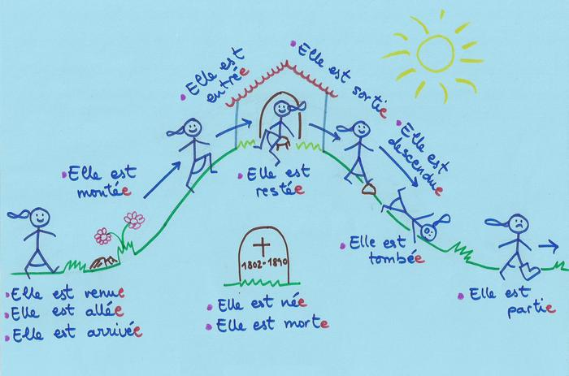
LE FÉMININ DU PASSÉ COMPOSÉ AVEC ÊTRE :

Slide 18
Reflexive verbs les verbes pronominaux
Mostly, reflexive verbs describe actions you do to yourself: je me lave – I get washed / I wash myself.
All reflexive verbs have a reflexive pronoun which changes according to the subject of the verb.
In the infinitive, all reflexive verbs start with se
In the passé composé, the auxiliary is être and the past participle agrees in number and gender.
Des exemples:
Se laver – to get washed
Se lever – to get up
Se réveiller – to wake up
Se promener - to go for a walk
Se raser – to have a shave
Se maquiller – to put on make up
Se doucher –to shower / take a shower
Se brosser les dents / les cheveux – to brush your teeth/hair
Se relaxer – to relax
De déshabiller – to get undressed
Se fâcher – to get angry
Se tromper – to be wrong
S’amuser –to enjoy yourself
S’appeler – to be called
S’ennuyer – to get bored
S’habiller – to get dressed
S’imaginer – to imagine
Je me lave
Tu te laves
Il se lave
Elle se lave
On se lave
Nous nous lavons
Vous vous lavez
Ils se lavent
Elles se lavent
Je me suis lavé(e)
Tu t’es lavé(e)
Il s’est lavé
Elle s’est lavé(e)
On s’est lavé(e)s
Nous nous sommes lavé(e)s
Vous vous êtes lavé(e)(s)
Ils se sont lavés
Elles se sont lavées
Le présent
Le passé composé
Je m’…

Slide 19
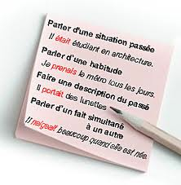
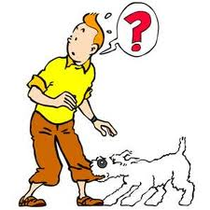
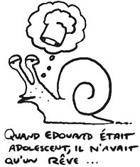
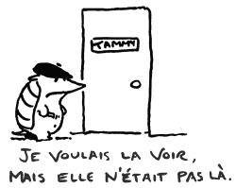

Slide 20
L’imparfait – the imperfect tense
The imperfect tense is a past tense. It is used to say what used to* happen, what was happening, what you were doing and for describing in the past.
*You may not always use the words used to in English, but if you could replace what you are thinking in English with those words, then the imperfect tense is what you need in French!
EXEMPLE: “When I was young, I went to school in Sidley…” means in other words:
“When I used to be young, I used to go to school in Sidley…” so you would need the imperfect tense of the verbs to be (être) and to go (aller) to say this in French!
« Quand j’étais* jeune, j’allais à l’école à Sidley »
To make the imperfect tense:
Start with the NOUS form of the PRESENT tense.
Take away the –ONS from the end of the verb. This leaves you with the stem.
EXEMPLE: (nous) jouons jouons jou-
(nous) finissons finissons finiss-
(nous) vendons vendons vend-
3. Add the right ending:
Je – ais
Tu – ais
Il / elle - ait
Nous – ions
Vous – iez
Ils - aient
Elles
*Only one verb in the imperfect tense has an irregular stem! The stem of être = ét-
The endings are the same as for all other verbs!

Slide 21
L’imparfait – the imperfect tense
- des exemples
J’étais…
J’avais…
Tu allais…
Tu voulais…
Il disait…
Il pensait…
Elle finissait…
Elle devait…
On faisait…
I was… / I used to be…
I had / I used to have / I was having…
You were going / you went / you used to go…
You wanted / you used to want…
He was saying / he said / he used to say…
He was thinking / he thought / he used to think…
She was finishing / she finished / she used to finish..
She was having to / she had to / she used to have to…
We did OR made / we used to do /make…
Nous prenions…
Nous riions…
Vous portiez…
Vous voyiez…
Ils habitaient…
Ils buvaient…
Elles visitaient…
Elles achetaient…
We were taking / we took / we used to take…
We were laughing / we laughed / we used to laugh…
You were wearing / you wore / you used to wear…
You were seeing / you saw / you used to see…
They were living / they lived / they used to live…
They were drinking / they drank / they used to drink
They were visiting / they visited / they used to visit
They were buying / they bought / they used to buy

Slide 22
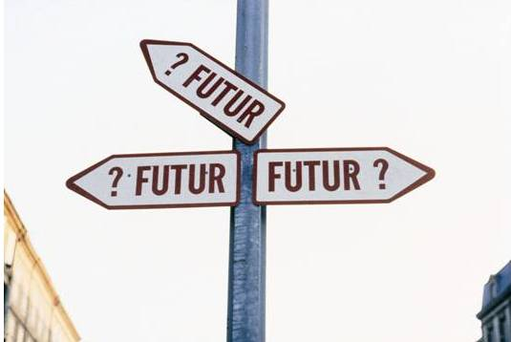
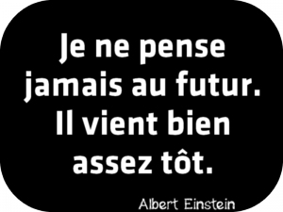
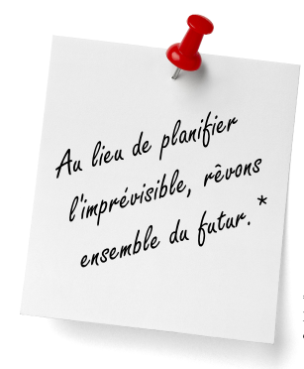

Slide 23
Le futur proche – the near future tense
Je vais
Tu vas
Il va
Elle va
Nous allons
Vous allez
Ils vont
Elles vont
The near future tense talks about things which are going to happen; they have not happened yet!
It is formed exactly as in English: use the present tense of aller – to go, plus the infinitive of another verb!
Je vais nager – I’m going to swim
aller – to go
visiter – to visit
acheter – to buy
faire – to do
jouer – to play
voir – to see
regarder – to watch
essayer – to try
être – to be
avoir – to have
prendre – to take
boire – to drink
manger – to eat

Slide 24
Qu’est-ce que tu vas faire?
Je vais aller …
Je vais visiter …
Tu vas voir …
Vas-tu faire?
Il va acheter…
Elle va demander…
On va partir…
Nous allons jouer…
Nous allons pouvoir (+ infinitive)…
Vous allez réussir…
Allez-vous être…?
Ils vont savoir…
Elles vont avoir…
I’m going to go…
I’m going to visit…
You are going to see…
Are you going to do…?
He is going to buy…
She is going to ask…
We’re going to leave…
We’re going to play…
We’re going to be able to…
You are going to succeed…
Are you going to be…?
They are goingto know…
They are going to have…

Slide 25
Le futur simple
Le futur proche – the near future tense – refers to things which ARE GOING to happen.
Le futur simple – the future tense – refers to things which WILL happen.
We have these two different ways of expressing the future in English.
This may be the easiest tense to learn in French.
Regular verbs:
Des exemples:
The stem of regular –er and –ir verbs is the infinitive.
Exemple:
Jouer- manger- parler-
FUTURE TENSE ENDINGS:
J’attendrai – I will wait
Tu travailleras – you will work
Il finira – he will finish
Elle rougira – she will blush
On partira – we will leave
Nous suivrons – we will follow
Vous introduirez – you will introduce
Ils mangeront – they will eat
Elles joueront – they will play
Add the following endings to the stem:
Je -ai
Tu -as
Il -a
Elle -a
On -a
Nous -ons
Vous -ez
Ils -ont
Elles -ont
The stem of regular –re verbs is the infinitive MINUS THE FINAL –E!
Exemple:
VENDRE PRENDRE ATTENDRE

Slide 26
Le futur simple - Irregular verbs:
A few common verbs have an irregular stem which must be learnt by heart!
The endings remain the same, even if the stem is irregular.
INFINITIVE: IRREGULAR
STEM:
FUTURE TENSE ENDINGS:
DES EXEMPLES:
Aller -to go
Avoir -to have
Courir -to run
Devoir -to have to
Devenir – to become
Envoyer -to send
Être -to be
Faire -to do, make
Mourir -to die
Pouvoir -to be able
Recevoir - to receive
Savoir – to know
Venir – to come
Voir – to see
Vouloir – to want
Add the following endings to the stem:
Je -ai
Tu -as
Il -a
Elle -a
On -a
Nous -ons
Vous -ez
Ils -ont
Elles -ont
Je pourrai - I will be able to
Je ferai – I will do / I will make
Tu auras – you will have
Tu sauras - you will know
Il mourra – he will die
Il devra – he will have to
Elle courra – she will run
Elle enverra – she will send
On verra – we will see
Nous recevrons – we will receive
Nous serons – we will be
Vous aurez – you will have
Vous voudrez – you will want
Ils viendront – they will come
Elles deviendront – they will become
ir-
aur-
courr-
devr-
deviendr-
enverr-
ser-
fer-
mourr-
pourr-
recevr-
saur-
viendr-
verr-
voudr-

Slide 27
Le Conditionnel
What would you do?
You need the stem of the futur simple – both regular and irregular stems are exactly the same!
You need the following endings:
The conditional tense talks about what would happen, what you would do etc
Je -ais
Tu -ais
Il -ait
Elle -ait
On -ait
Nous -ions
Vous -iez
Ils -aient
Elles -aient
It is easy peasy, lemon squeezy!
Des Exemples:
Je voudrais
Je mangerais
Tu irais
Tu ferais
Il aimerait
Elle jouerait
On saurait
I would like
I would eat
You would go
You would do / make
He would like
She would play
We would know
Nous finirions
Nous pourrions
Vous viendriez
Vous devriez
Ils comprendraient
Elles arriveraient
Elles seraient
We would finish
We’d be able to/ could
You would come
You would have to / should
They would understand
They would arrive
They would be

Slide 28
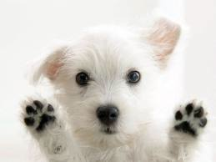
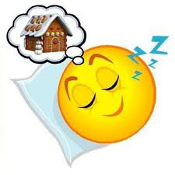
‘Si’ clause
“If I had a dog, it would be great”
« Si j’avais un chien, ce serait formidable »
Si means if.
To use a ‘si’ clause in your work, the first verb must be in the imperfect and the second verb in the conditional.
Si j’étais très riche, j’habiterais dans les Alpes et je ferais du ski tous les jours…
Si je pouvais choisir, les vacances scolaires seraient plus longues…

Slide 29
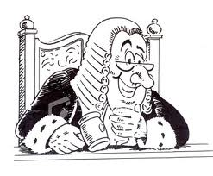
Le subjonctif
The subjunctive is a ‘mood’, rather than a tense.
The mood it conveys is normally one of doubt, judgement, emotion, necessity or possibility.
Certain expressions in French always require a subjunctive. Some useful ones are:
bien que – although- il faut que – it is necessary that - jusqu’à ce que – until (when it is
not followed by a time) - je ne crois/pense pas que… – I don’t believe/think that…
pour que – so that – vouloir que – to want that … préférer que –to prefer that
The subjunctive is mainly used in its present tense form.
To make the stem of the subjunctive: 1) take the ils/elles form of the present tense indicative: 2) remove the –ent from the end 3) add: e/es/e/ions/iez/ent
These common verbs have an irregular stem:
aller | avoir | être | faire | pouvoir | savoir | venir | vouloir
J’aille Tu ailles Il aille Elle aille Nous allions Vous alliez Ils aillent Elles aillent | J’aie Tu aies Il ait Elle ait Nous ayons Vous ayez Ils aient Elles aient | Je sois Tu sois Il soit Elle soit Nous soyons Vous soyez Ils soient Elles soient | Je fasse Tu fasses Il fasse Elle fasse Nous fassions Vous fassiez Ils fassent Elles fassent | Je puisse Tu puisses Il puisse Elle puisse Nous puissions Vous puissiez Ils puissent Elles puissent | Je sache Tu saches Il sache Elle sache Nous sachions Vous sachiez Ils sachent Elles sachent | Je vienne Tu viennes Il vienne Elle vienne Nous venions Vous veniez Ils viennent Elles viennent | Je veuille Tu veuilles Il veuille Elle veuille Nous voulions Vous vouliez Ils veuillent Elles veuillent

Slide 30
Le subjonctif -des exemples
Bien que j’aie deux soeurs, j’ai ma propre chambre.
Je ne peux pas aller au ciné parce qu’il faut que je fasse mes devoirs de maths.
Mes grands-parents veulent que j’aille chez eux ce week-end.
Je ne crois pas que mon frère puisse venir avec moi.
Je préfère que les gens soient honnêtes et aimables.
Je révise tous les soirs pour que je comprenne le français!
J’attends devant la gare jusqu’à ce que mon père vienne me chercher.
Although I have two sisters, I have my own bedroom.
I can’t go to the cinema because I must do my maths homework.
My grandparents want me to go to their house this weekend.
I don’t think that my brother can come with me.
I prefer that people are honest and friendly.
I revise every night so that I understand French!
I’m waiting outside the station until my dad comes to pick me up.

Slide 31
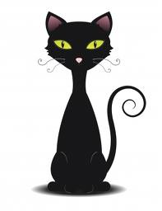
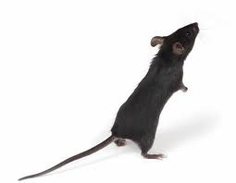
Les adjectifs
Adjectives describe nouns. In French, there are 2 main things that you need to know about adjectives and how to use them:
Most adjectives follow the noun. That means they come after it, not before it.
Most adjectives show the gender and the number of the noun they are describing.
That means they show whether a noun is masculine, feminine or plural.
When an adjective is describing a masculine, singular noun, there is no change to its spelling.
When an adjective is describing a feminine, singular noun, you usually add an –e (unless it already ends in –e)
When an adjective is describing a masculine, plural noun, you usually add an –s
When an adjective is describing a feminine, plural noun, you add –es
un chat noir
une souris noire
deux chats noirs
deux souris noires

Slide 32
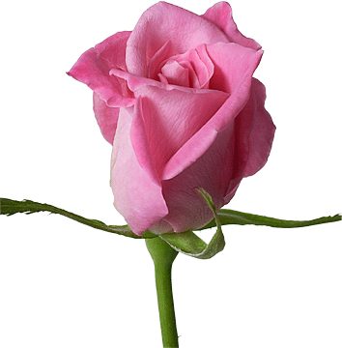
Les adjectifs – what you need to know!
If the adjective already ends in –e, you don’t add another one for the feminine!
EXEMPLE: facile (easy) riche (rich) jeune (young) ) jaune (yellow) pratique (practical
Some adjectives don’t change in the feminine or in the plural. Here are some examples:
Shortened adjectives | sympa (short for sympathique)
Adjectives coming from another language | cool, top (great, best ), jazzy, solo, vidéo, pop, soul, punk, tango (bright orange), snob (snobby, snobbish)
Adjectives derived from nouns | marron (brown –un marron = a chestnut) or (gold) argent (silver) emeraude (emerald green) cerise (cherry red) orange, turquoise
Compound colour adjectives | bleu clair (light blue) vert foncé (dark green) bleu marine (navy blue) rouge tomate (tomato red) bleu vert (bluey green)
Chic (stylish) doesn’t agree either…
Rose (pink) DOES agree, even though it’s also a noun!

Slide 33
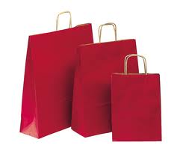
Some adjectives go in front of the noun
they are describing.
These adjectives go in the BAGS and they are connected with:
B A G s
EAUTY
GE
OOD /BAD
IZE
JOLI - PRETTY
BEAU - HANDSOME /
BEAUTIFUL
JEUNE - YOUNG
VIEUX - OLD
BON - GOOD
MAUVAIS - BAD
VILAIN - NASTY
MEILLEUR - BETTER
PIRE - WORSE
EXCELLENT –
EXCELLENT
PETIT - SMALL
GRAND – BIG
/GREAT
COURT - SHORT
LONG - LONG
GROS – BIG/
LARGE

Slide 34
Irregular adjective patterns
Some adjectives do more than simply add an –e or an –s at the end. Their ending will vary, according to the gender of the noun they describe like this:
If it ends like this: | The feminine will change to this: | Des exemples: Masculine singular | Femininine singular | Masculine plural | Feminine plural
-et* | -ète | inquiet | inquiète | inquiet | inquiètes
-er | -ère | cher | chère | chers | chères
-eur | -euse | heureux | heureuse | heureux | heureuses
-x | -se | jaloux | jalouse | jaloux | jalouses
-f | -ve | sportif | sportives | sportifs | sportives
-c | -che / que | franc turc | franche turque | francs turcs | franches turques
-eil, -el, -an, -on, -en, -et* -ot, -as | Double consonant + e | cruel net | cruelle nette | cruels net | cruelles nettes
favori | favorite | long | longue
frais | fraîche | doux | douce
roux | rousse | gros | grosse
épais | épaisse | meilleur | meilleure
gentil | gentille
There are exceptions
to this rule!:

Slide 35
More facts about adjectives:
Some adjectives have irregular singular and plural forms, but they all have a pattern in common. These adjective are in the BAGS and go in front of the noun:
Masculine singular | Masculine singular before a noun | Feminine singular | Masculine plural | Feminine plural
beau | bel | belle | beaux | belles
nouveau | nouvel | nouvelle | nouveaux | nouvelles
vieux | vieil | vieille | vieux | vieilles
There are some adjectives which can go either before or after the noun they are describing. However, their meaning will change, according to where they are placed.
BEFORE AFTER
BEFORE AFTER
ancien | old (as in old friend) | ancient
brave | fine, amiable, | brave, courageous
certain | certain - some | certain – definite
cher | dear (beloved) | dear (expensive)
curieux | curious - strange | curious - inquisitive
dernier | final, last ever | last (as in last week)
grand | great | tall
gros | big | fat
même | same | very (le jour même-the very day)
pauvre | Poor – to be pitied | Poor – without wealth
prochain | Next – usually in front of the noun | Next – with time phrases = after the noun – la semaine prochaine
propre | own | clean
pur | pure - simple, plain | pure - unaltered, unsullied
rare | rare - precious | rare - infrequent
sale | nasty, rotten | dirty
seul | only, sole | lonely / alone
simple | simple - pure | simple – not complex
véritable | real | real - genuine
vrai | real | true

Slide 36
calligramme

